Slide 1
L-Store
Authors:
Sheng Yee Siow (Team Coordinator)
Brandon Jones Gunaman (Systems Architect)
Ryan Chak Hin Chan (Developer)
Vivienne Amy Zing (Tester)
Jenna Samantha Zing (Developer)

Slide 2
Data Structure
Stores Ranges ‘List’ in Tables Class:
Each element in the Ranges class:
Corresponds to a particular Update Range
Consists of a Matrix of Pages, 2here each row in the matrix is a Set of Pages,
A Set of Pages is a list of pages which holds data for the same records
Consists of 2 Sets Base Pages and an Undefined amount of Sets Tail Pages

Slide 3
Architecture
Ranges:
Range 0 | Range 1 | Range 2 | Range 3
Range 0:
Has Base pages with RID 1-1024
Range 1:
Has Base pages with RID 2049-3072
Set 0:
Ind | rid | end | tstp | col1 | col2 | col3 | col4 | col5
Set 1:
Ind | rid | end | tstp | col1 | col2 | col3 | col4 | col5
Set 2:
Ind | rid | end | tstp | col1 | col2 | col3 | col4 | col5
Page

Slide 4
Architecture
Ranges are allocated as needed: if base page rid reaches limit
Sets are allocated as needed
Tail pages are allocated as needed
New base Pages are allocated as needed(each range only has 2 sets of base pages)
Base and Tail sets can be alternating
Use a list ‘tail_tracker’: to track the set index of the latest tail page in each range

Slide 5
Page Directory: RID->Physical Location
A Map :
Key: RID
Value: Physical Location
Physical Location : (Range Index, Set Index, Offset)
Range Index: RID / Number of Records per Range
Set Index: ((RID - 1) % Number of Records per Range) / Number of Records Per Set
Offset: (RID - 1) % Number of Records Per Set

Slide 6
Key Directory: Key -> Physical Location
A Map
Key: Primary Key
Value: Physical Location
Optimizes Select, Update and Sum
Database don’t have to look to Page Directory after looking at Key Directory

Slide 7
Insert
Initialize the record
Store its physical location in the page directory
Store its key in the page directory
If there’s no space, create a new page or new range

Slide 8
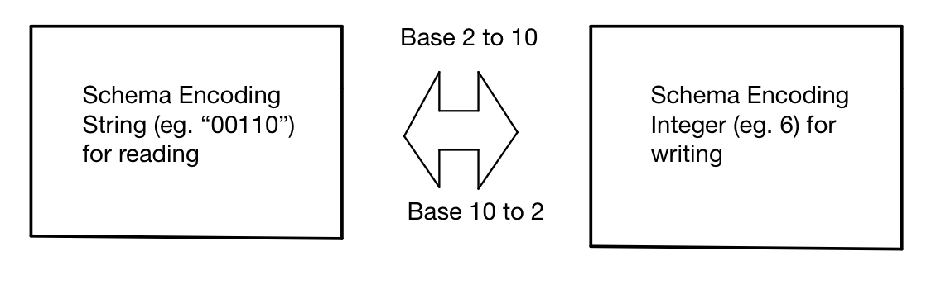
Storing Schema Encoding (str -> int)
For uniform storage of integers across every column:

Slide 9
Update
Find location of base record using key directory
Construct schema encoding for current update (new tail record)
Calculate offset of the new tail record on the page and create new tail page if necessary
Insert current tail record into page directory
Find the most recent updated record and retrieve latest values and rid
Update indirection and schema encoding in the base record
Write the new tail record
Notes:
Key directory gets the key and returns the location of the base record that the update corresponds to. We want to find the indirection to lead us to the latest tail record. If a record has not been updated yet, indirection = 0.
Parse the update columns: None = append 0, else append 1(string)
Check if a tail page exists (we have a tail tracker that stores the index of the latest tail page in the range). Check size of the page to determine if we need to allocate a new page. Check the offset from the start of the page by using the number of records already in the page
Add to dictionary so we can access location of new tail if needed
Track the latest updated record to get values of columns (cumulative) so we can write to columns the current update does not update. RID retrieved is the indirection of the tail.
Construct a new schema encoding that states which columns have been updated. Use a bitwise OR operator on the base schema and the new constructed schema in step 2. Write the rid of the new tail to the indirection of the base.
Write the new tail record into memory.

Slide 10
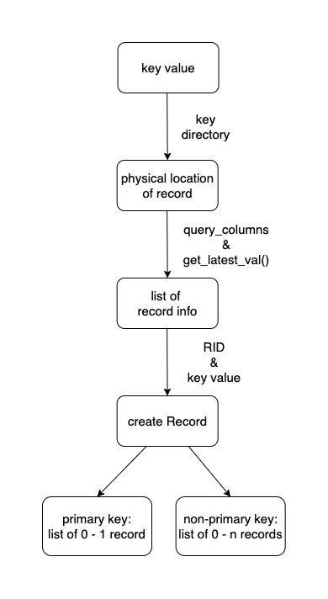
Select
NOTE: currently using primary key implementation
Validate key
Get physical location of record
Generating a list of record info (based on selected query_columns)
Create Record
Notes:
Check to make sure the key we’re given is valid (exists within the key directory)
Based on the key, get the physical location of the record
Create an empty list that we will populate with either the selected columns most up to date value or ‘None’ by looping through query_columns and calling get_latest_val()
get_latest_val() determines if what we are looking for is in a base record or tail record returning the most up to date value at the location we specified (also takes into account deleted records)
Based on the populated list we generated, we will create a new record and insert it into a list

Slide 11
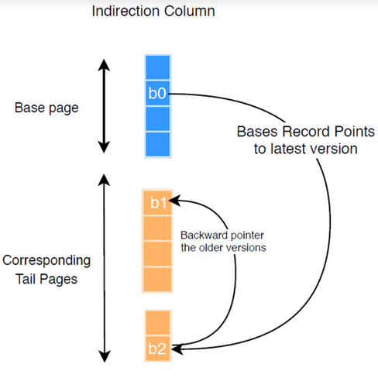
Delete
Access key index to find location of base record
Mark RID of base record as invalid value
If indirection column is not invalid
Move to tail record specified in indirection column
Mark RID of tail record as deleted

Slide 12
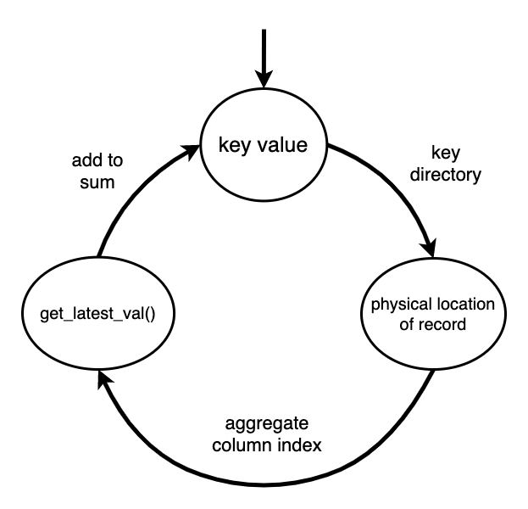
Sum
For current key:
Validate key
get physical location of record
Add latest value from aggregate column index to sum
Notes:
Check to make sure the keys we’re given are valid (exists within the key directory)
Get the physical location of the starting record
Set the sum value equal to the starting records specified value by calling get_latest_val()
In a loop, increment the starting keys value by one until you reach the ending keys value, following the same pattern of checking if the record exists, getting the physical location and incrementing the sum value

